Slide 1

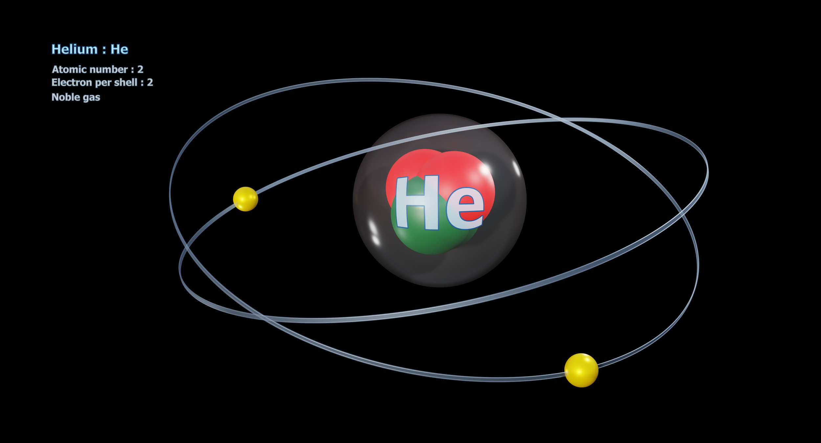
Solving the Schrödinger Equation for Helium Using Atomic Units
By Seveli Kaur

Slide 2





ĤΨ=EΨ
n=4
n=3
n=2
n=1

Slide 3





HΨ(r₁, r₂) = EΨ(r₁, r₂)
HΨ(r)=EΨ(r)
Ψ(r1, r2) ≠ ψ₁(r1) × ψ₂(r2)
repulsion
r₁
r₂
Helium Atom

Slide 4



1/|r₁ − r₂|
Both Energies of Electron depends on each other
Ψ(r1, r2) ≠ ψ₁(r1) × ψ₂(r2)
cannot seperate (multi-body system)

Slide 5
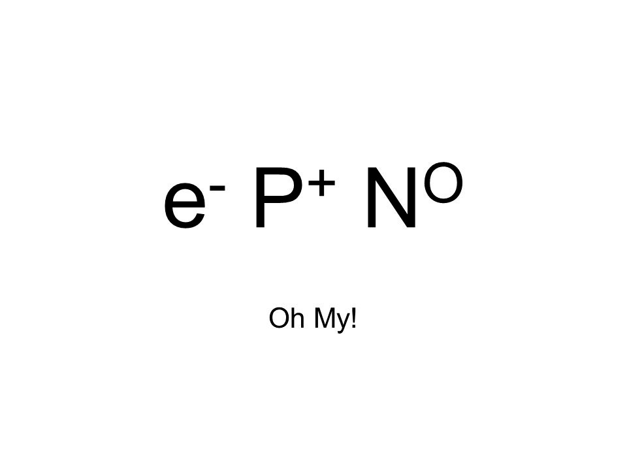







Hard to Track
Unit
Miss
Bulky
Ĥ

Slide 6








Slide 7


Ground State Energy = -2.90
r₁
r₂

